Slide 1

Azure
New
Zealand North

Slide 2

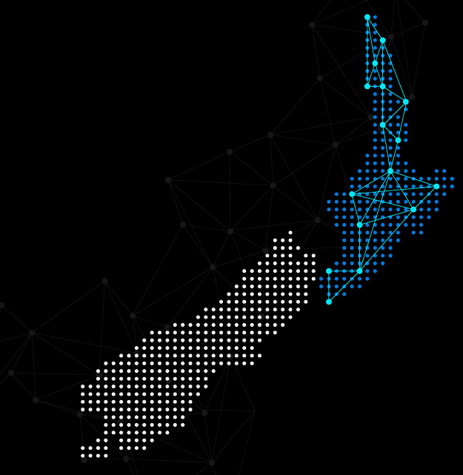
Hello!
Thank you for joining us today
Speaker: Luke Murray
Microsoft Learn Expert and Microsoft Azure MVP, and Senior Consultant from Hamilton, New Zealand.
https://x.com/lukemurraynz
https://www.linkedin.com/in/ljmurray/
https://luke.geek.nz/

Slide 3
Regions and availability zones
Region
Availability Zone 1
Datacenter(s)
Availability Zone 2
Datacenter(s)
Availability Zone 3
Datacenter(s)
Availability Zone 1
Availability Zone 2
Availability Zone 3

Slide 4

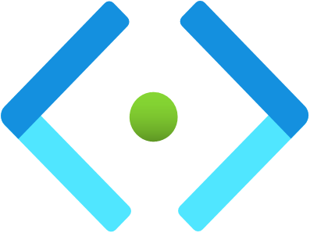
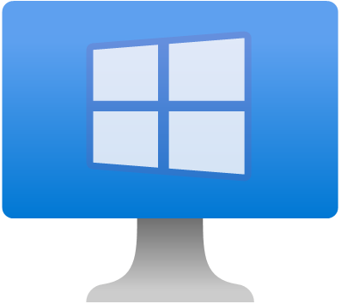
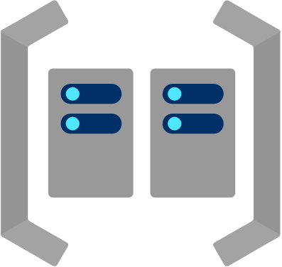
New Zealand North
vnet-spoke1-nzn
default (subnet - 10.0.1.0/24)
Availability Zone 1
VM1 (10.0.1.4)
VM2 (10.0.1.5)

Slide 5
New Zealand North
vnet-spoke1-nzn
default (subnet - 10.0.1.0/24)
Availability Zone 1
VM1 (10.0.1.4)
VM3 (10.0.1.6)

Slide 6
New Zealand North
vnet-spoke1-nzn
default (subnet - 10.0.1.0/24)
Availability Zone 1
VM1 (10.0.1.4)
Availability Zone 2
VM4 (10.0.1.7)
Availability Zone 3
VM5 (10.0.1.8)

Slide 7
New Zealand North
vnet-spoke1-nzn
default (subnet - 10.0.1.0/24)
Availability Zone 1
VM1 (10.0.1.4)
vnet-spoke2-nzn
default (subnet - 10.0.2.0/24)
Availability Zone 1
VM2 (10.0.2.4)

Slide 8
New Zealand North
vnet-spoke1-nzn
default (subnet - 10.0.1.0/24)
Availability Zone 1
VM1 (10.0.1.4)
vnet-spoke2-nzn
default (subnet - 10.0.2.0/24)
Availability Zone 2
Availability Zone 3
VM3 (10.0.2.6)
VM4 (10.0.2.5)

Slide 9


New Zealand North
vnet-spoke1-nzn
default (subnet - 10.0.1.0/24)
Availability Zone 1
vnet-hub-nzn
(10.0.0.0/24)
VM1 (10.0.1.4)
Firewall (10.0.0.68)
vnet-spoke2-nzn
default (subnet - 10.0.2.0/24)
default (subnet - 10.0.3.0/24)
Availability Zone 2
Availability Zone 3
VM2 (10.0.2.6)
VM3 (10.0.3.4)

Slide 11
Architecting for Azure

Slide 12
Architecting for Azure
1
2
3
Cloud Adoption Framework
Azure Architecture Center
Well-Architected Framework
Proven guidance and best practices that help you confidently adopt the cloud and achieve business outcomes.
Guidance for architecting solutions on Azure using established patterns and practices
A set of quality-driven tenets, architectural decision points, and review tools intended to help solution architects build a technical foundation for their workloads.
https://learn.microsoft.com/azure/cloud-adoption-framework/
https://learn.microsoft.com/azure/architecture/
https://learn.microsoft.com/azure/well-architected/

Slide 13
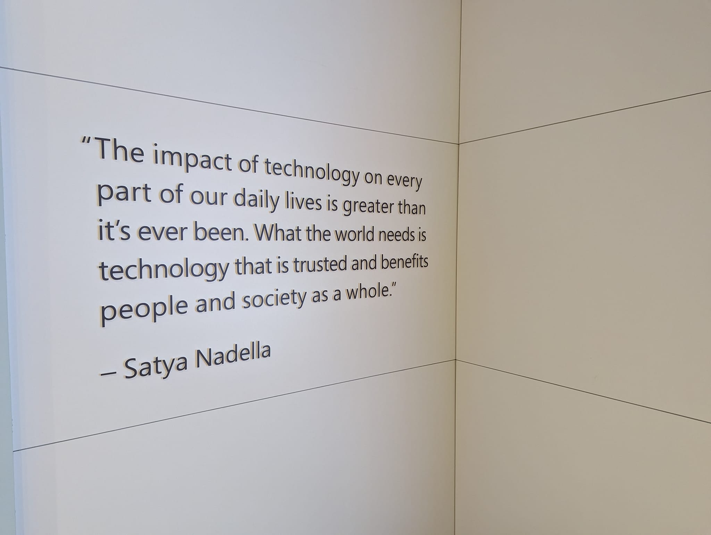

Slide 14
The time is now, go build!

